Slide 2
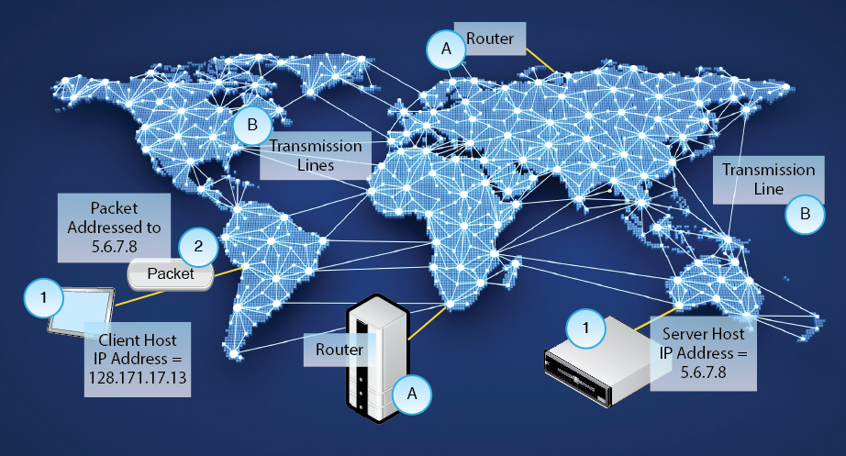
Corporate Wide Area Networks (WANs)
Chapter 10

Slide 3
10.1: LANs versus WANs (and MANs)
Category | Local Area Network | Wide Area Network
Abbreviation | LAN | WAN
Service Area | On customer premises (home, apartment, office, building, campus, etc.) | Between sites in a region, a country, or around the world.
Implementation | Self. | Carrier.
Cost per bit | Low | High.
Typical speed | Gigabits per second | 1 to 100 Mbps typical

Slide 4
Corporate WANs
2
The Internet
Ubiquitous and inexpensive
Lacks the QoS requirements of organizations
Corporate WANs
For transmission between a corporation’s sites
Offer the required QoS
Offer manageability
Much more expensive than the Internet to meet traffic engineering requirements

Slide 5
10.4: The Public Switched Telephone Network (PSTN)
Residential Access

Slide 6
10.5: Asymmetric Digital Subscriber Line (DSL) Service for Residences

Slide 7
10.6: Cable Modem Service
3
1
6
4
7
8
5
2

Slide 8
10.7: Coaxial Cable
Two conductors: central wire and coaxial ring

Slide 9
ADSL versus Cable Modem Service
In general …
Cable modem service offers somewhat faster individual throughput at a somewhat higher cost.
ADSL service offers somewhat slower individual throughput at a somewhat lower cost.
Both types of carrier and new entrants are bringing fiber to the home for far faster speeds

Slide 10
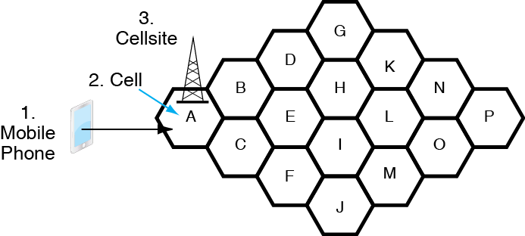
10.8: Cellular Telephone Service
Note that a cell is a geographical region while a cellsite is a building with cellular equipment

Slide 11
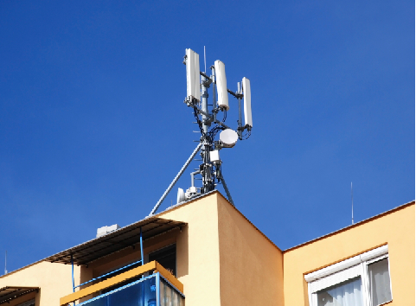
10.9: Cellsite for Mobile Telephones
Cellular
Antennas
Point-to-Point Microwave
Antenna to MTSO
Cellsite

Slide 12
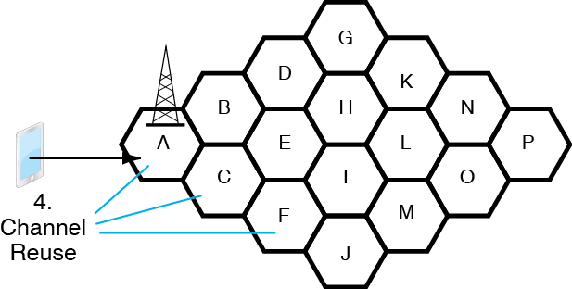
10.8: Cellular Telephone Service
4.
A channel can be reused in multiple cells.
The carrier can serve more customers.

Slide 13
Cellular Technology
Channel Reuse
Example without channel reuse:
If 500 channels, only 500 simultaneous subscribers can be served in the entire system.
Example with channel reuse in each cell
500 channels
100 cells
Can serve 50,000 simultaneous subscribers

Slide 14
10.8: Cellular Technology
If you travel between cells, you will be handed off to a new cell site in the new cell (P)

Slide 15
10.10: Cellular Data Speeds
Speeds
Early cellular systems were limited to about 20 kbps
Today, most carriers give peak download speeds of 5 to 10 Mbps with the best giving 15 to 20 Mbps
100 Mbps is on the horizon
Nearly all carriers now use LTE (long-term evolution) technology

Slide 16
10.10: Cellular Data Speeds
LTE Advanced
The next generation of LTE
Currently, speeds are required to be 3 Gbps downstream, half of that upstream
3G, 4G, and 5G
The ITU creates definitions of generations
Marketers are using the terms in a meaningless manner

Slide 17
10.10: Cellular Data Speeds
Throughput Differs Widely from Rated Speeds
If the user is riding in a car, throughput will fall.
If more customers use a cellsite, the cellsite must decrease the transmission speed to each.
In particular, changing numbers of users means that speed will depend on the time of day.
Copyright © 2015 Pearson Education, Inc.

Slide 18
10.12: Access Lines vs Leased Lines
Corporate
Site
Each customer site must have a CSU/DSU interface to the telephone network.
Trunk
Link
Corporate
Site or Carrier Point of Presence (POP)
Corporate
WANs
Trunk
Link

Slide 19
10.13: Leased Line Data Network
There are many types of leased lines with different speeds (and prices)

Slide 20
10.13: Leased Line Data Network
Company must plan, install, and operate its own leased line network

Slide 21
10.18 MPLS Networks
MPLS Carrier provides a business WAN service
Carrier does all of the management work
Customers only need leased lines to MPLS Carrier POPs
Points of Presence
Access points to the MPLS network
Carrier MPLS Network
Company
POP
Leased Line

Slide 22
10.18: Multiprotocol Label Switching (MPLS)

Slide 23
10.18: Multiprotocol Label Switching (MPLS)
Each label-switched path is given a label number, which is placed before each packet.
Router 3 sends the packet out through Interface 1

Slide 24
10.18: Multiprotocol Label Switching (MPLS)
However managing traffic engineering is expensive, so MPLS costs more than using the Internet

Slide 25
Using the Internet for Corporate WAN Transmission
New: Not in Book
Advantages Compared to MPLS
Inexpensive per bit transmitted compared to MPLS
Reaches Everywhere
Disadvantages Compared to MPLS
No security
No SLAs
No ability to manage in detail

Slide 26
Hybrid WANs
New: Not in Book
Concept
Use the Internet for traffic that allows it
Use MPLS for traffic that needs it
Implementation
Far easier said than done
Requires network management software that can implement it

Slide 27
Mixing and Matching
New: Not in Book
In general, must use multiple carriers and services
Leased lines between sites are often the only alternatives
MPLS carriers may be regional
May have to deal with several
Interoperability is often limited
Use the Internet where you can
Corporate WANs are a patchwork

Slide 28
All Pau

